Slide 1
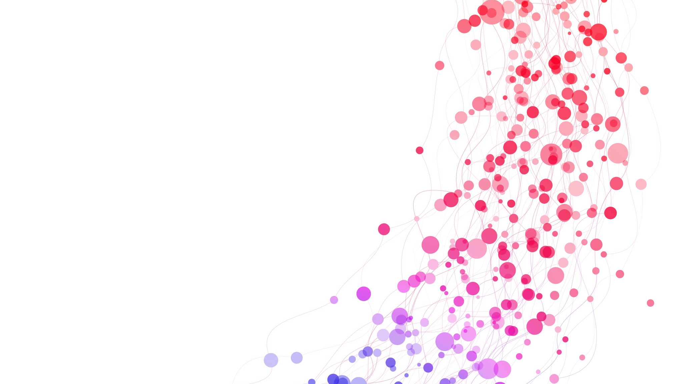
Transactions don’t exist
What to do if…

Slide 2
Where don’t transactions work?

Slide 3
What happens if you do nothing?

Slide 4
Clean up afterwards?

Slide 5
Can you do a SAGA?

